Slide 1

Data Visualizations
Monday May 11, 2020

Slide 2
Theory of Data Graphics
Building a Great Visual
ggplot() basics
Questions?

Slide 3
Theory of Data Graphics

Slide 4
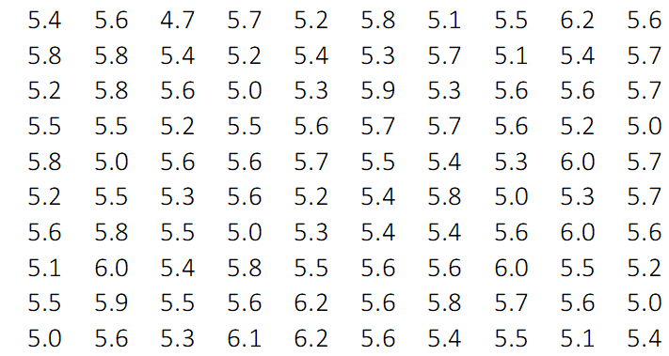
Theory of Data Graphics
Data Graphics
Why Data Graphics?
Numbers are hard, pictures are easy.
What is the meaning behind all of these numbers?

Slide 5
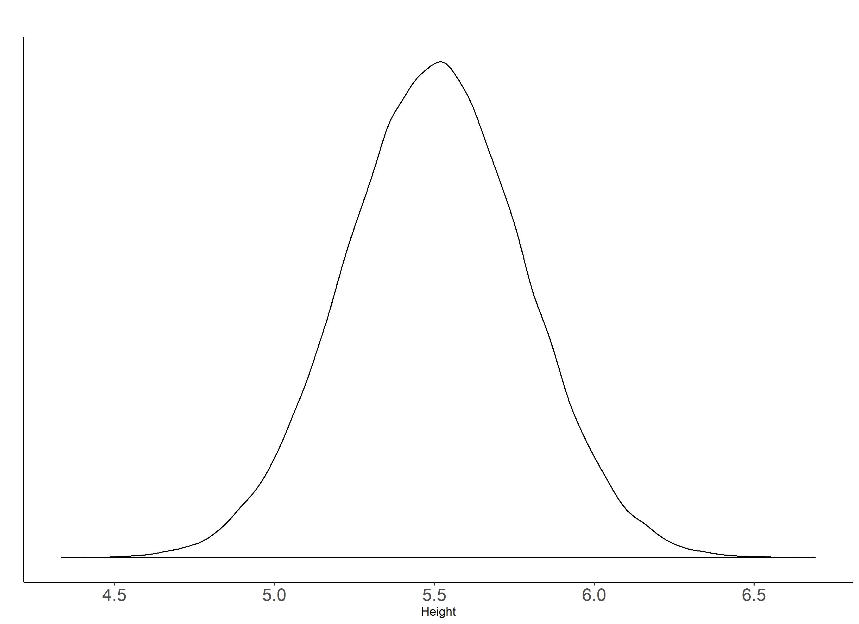
Theory of Data Graphics
Data Graphics
Why Data Graphics?
Numbers are hard, pictures are easy.
What is the meaning behind all of these numbers?
Distribution of Employees’ Heights at Ankura

Slide 6
Theory of Data Graphics
Data Graphics
Why Data Graphics? Because pictures have meaning where numbers may not.
Distribution of Employees’ Heights at Ankura

Slide 7
Theory of Data Graphics
Data Graphics
Let’s take it a step further.
Let’s color code men vs. women’s heights.
With additional information, we can plot the data again, and this time tell a different story.

Slide 8
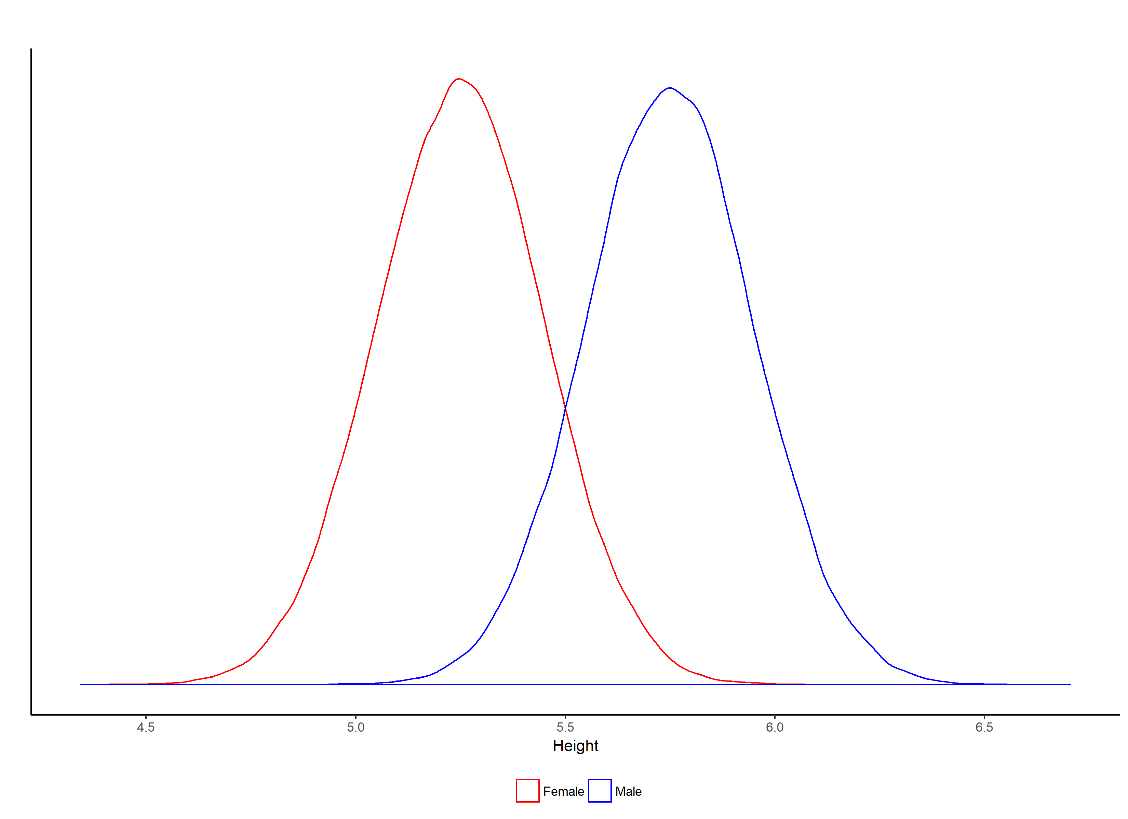
Theory of Data Graphics
Data Graphics
Let’s take it a step further.
On Average, Men are Taller than Women at Ankura
Our story has a simple conclusion:
On average, Men are taller than Women.
However, some Women will be Taller than Men.

Slide 9
Theory of Data Graphics
Data Graphics
What is the moral of this story?
Data is so large that analyzing and interpreting it becomes very difficult.
Translating large amounts of data into a graph is a good way of highlighting a pattern or a trend.
Analyzing a lot of data is pretty useless, unless you can tell a good story from it.
Graphs help elucidate that story.

Slide 10
Theory of Data Graphics
Data Graphics
A few things to remember before we go on:
Long, cumbersome tables may convey lots of information, but often do not tell the story in a simple and meaningful way.
Graphs have high data density. This means that more information can be conveyed with less space than with a table or text.
Graphs can highlight a pattern or a trend better than text or a table.

Slide 11
Building a Great Visual

Slide 12
Theory of Data Graphics
Building a Great Visual
The Four Os
Observable – The graphic contains a fact or a trend that a lay person can see. Visuals should speak for themselves.
Objective – The graphic does not attempt to hide a fact or trend, nor does it attempt to create one that is not there.
Open – The graphic is clear and concise. Simple is best!
Original – The graphic contains verifiable data sources

Slide 13
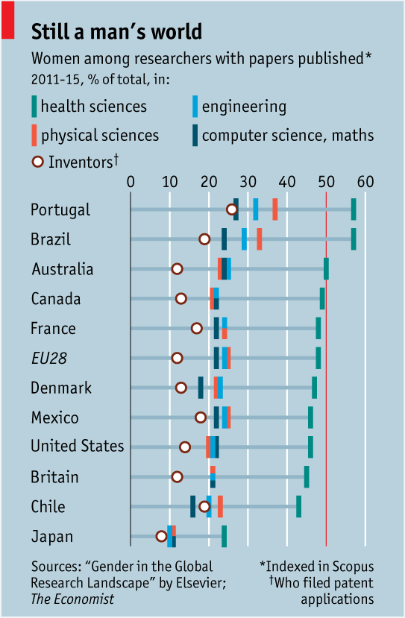
Theory of Data Graphics
Building a Great Visual
Observable – The graphic contains a fact or a trend that a lay person can see.

Slide 14
Theory of Data Graphics
Building a Great Visual
Observable – The graphic contains a fact or a trend that a lay person can see.
This graph buries any meaning. It is simply trying to convey too much in one picture.

Slide 15
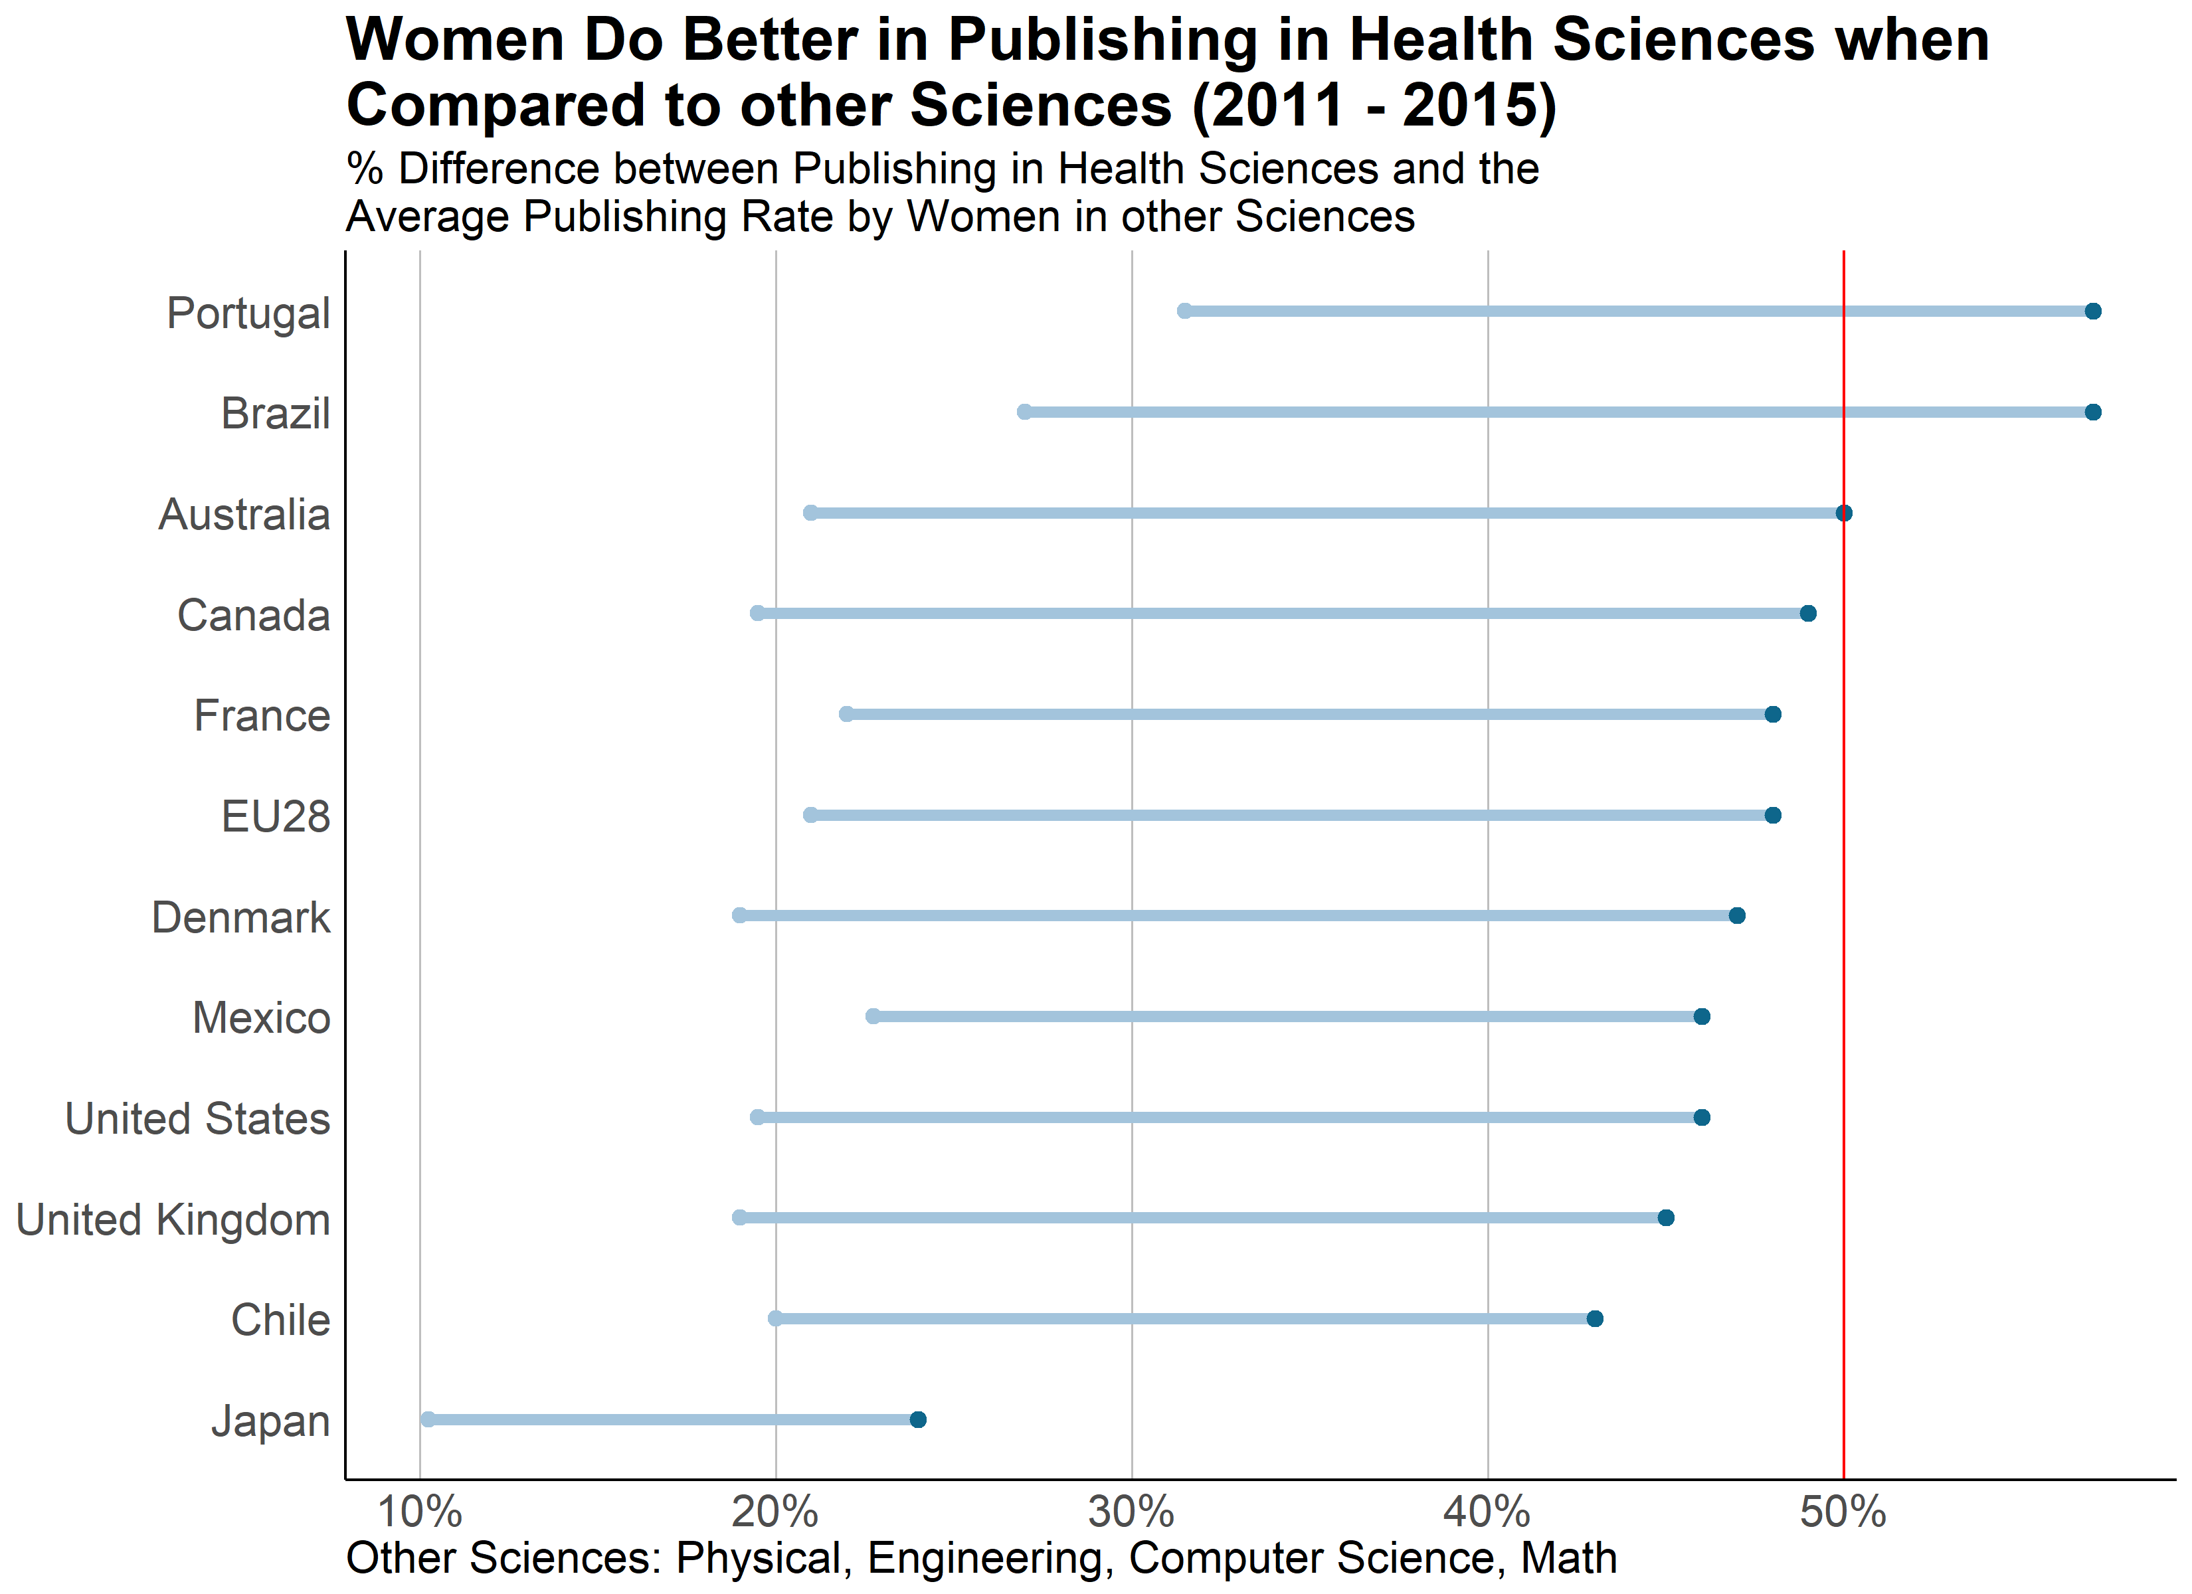
Theory of Data Graphics
Building a Great Visual
Observable – The graphic contains a fact or a trend that a lay person can see.
% Average
All Other
% Health

Slide 16
Theory of Data Graphics
Building a Great Visual
Observable – The graphic contains a fact or a trend that a lay person can see.
% Average
All Other
% Health
This is same data, but we had to make decisions to simplify the picture.

Slide 17
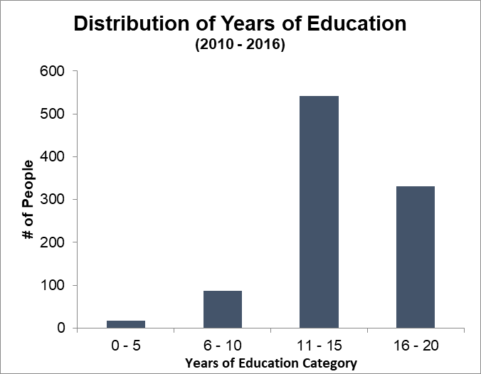
Theory of Data Graphics
Building a Great Visual
Objective – The graphic does not attempt to hide a fact or trend, nor does it attempt to create one that is not there.

Slide 18
Theory of Data Graphics
Building a Great Visual
Objective – The graphic does not attempt to hide a fact or trend, nor does it attempt to create one that is not there.
An easy way to mis-construe data is to play around with how it is categorized.

Slide 19
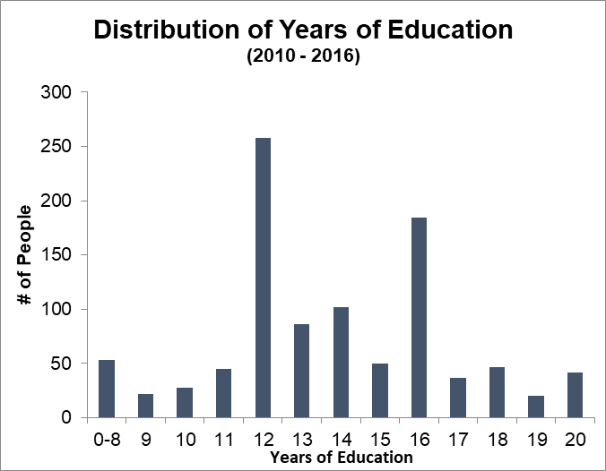
Theory of Data Graphics
Building a Great Visual
Objective – The graphic does not attempt to hide a fact or trend, nor does it attempt to create one that is not there.

Slide 20
Theory of Data Graphics
Building a Great Visual
Objective – The graphic does not attempt to hide a fact or trend, nor does it attempt to create one that is not there.
Very clearly, this graph shows a
bi-modal distribution in years of education.

Slide 21
Theory of Data Graphics
Building a Great Visual
Original – The graphic contains verifiable data sources

Slide 22
Theory of Data Graphics
Building a Great Visual
Original – The graphic contains verifiable data sources
Graphics should
Stand-alone.
Contain the data source used to create the graph
That data source should be reliable.
Source: General Social Survey, http://www.gss.norc.org/.
Variable: Non-Missing values of the field EDUC.

Slide 23
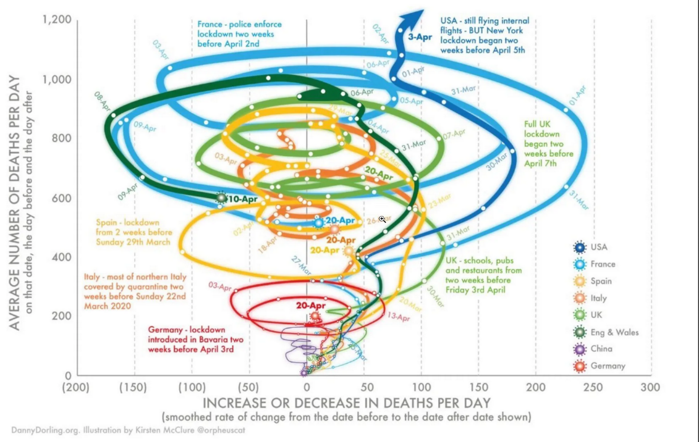
Theory of Data Graphics
Building a Great Visual
Open – The graphic is clear and concise. Simple is best!
Source: https://theconversation.com/three-graphs-that-show-a-global-slowdown-in-covid-19-deaths-135756

Slide 24
Theory of Data Graphics
Building a Great Visual
Open – The graphic is clear and concise. Simple is best!
Avoid chart junk and gimmicks. This graphic may look interesting, but it is hard to interpret. The whirlwinds look pretty, but the graphic is very hard to interpret and compare against the colors.
Source: https://theconversation.com/three-graphs-that-show-a-global-slowdown-in-covid-19-deaths-135756

Slide 25
Theory of Data Graphics
Building a Great Visual
Open – The graphic is clear and concise. Simple is best!
There is no quick fix for the graphic here. Some things to note when building your visual:
The message is clear
Comparisons between categories are obvious.
The title states a clear story.
Source: https://theconversation.com/three-graphs-that-show-a-global-slowdown-in-covid-19-deaths-135756

Slide 26
Theory of Data Graphics
Building a Great Visual
The Four Cs (sort of)
Title – A simple but descriptive title that explains the graph.
Citations – The graph should include ALL data sources and citations.
Caption – If the title is not enough to explain what is happening, then a caption should be added.
Colors – Proper use of color is key to helping tell the story. Balance is key.

Slide 27
Theory of Data Graphics
Building a Great Visual
Let’s Work through a Hypothetical
Suppose we are given 1,000,000 dialer records from a company facing potential TCPA liability. We can analyze and present this data in a variety of formats.
Written Narrative
Summary Table
Data Graphic

Slide 28
Theory of Data Graphics
Building a Great Visual
Let’s Work through a Hypothetical
Table 1: Number of Calls by Category

Slide 29
Theory of Data Graphics
Building a Great Visual
Let’s Work through a Hypothetical

Slide 30
Theory of Data Graphics
Building a Great Visual
Let’s Work through a Hypothetical

Slide 31
Theory of Data Graphics
Building a Great Visual
Let’s Work through a Hypothetical

Slide 32
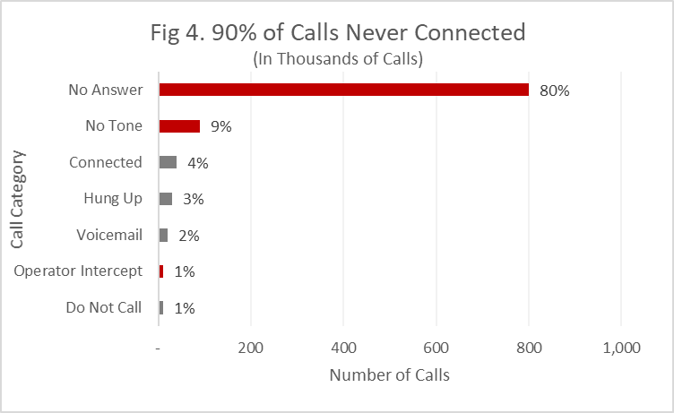
Theory of Data Graphics
Building a Great Visual
Let’s Work through a Hypothetical
Red indicates a call category that did not connect
Source: Shoutpoint Database, 2017 to 2018, Calls with non-missing durations.

Slide 33
Theory of Data Graphics
Building a Great Visual
Let’s Work through a Hypothetical
Descriptive Title
Use of Color to highlight the story
Caption
Red indicates a call category that did not connect
Citation to sources
Source: Shoutpoint Database, 2017 to 2018, Calls with non-missing durations.

Slide 34
Theory of Data Graphics
Building a Great Visual
How do we know what type of graph to choose?
So far, I have only presented column graphs.
However, different types of data dictate different types of graphs.
Some simple rules:
Categorical Data – Column / Bar Graph
Continuous Data – Histograms, Density Graph
Data that exists over time – Timelines
Relationships – Scatterplots

Slide 35
Theory of Data Graphics
Building a Great Visual
How do we know what type of graph to choose?
Beyond just your data, what you would like to show with your data dictates the types of graphs you should use.
Some additional considerations:
Comparison
Relationship
Composition
Distribution

Slide 36
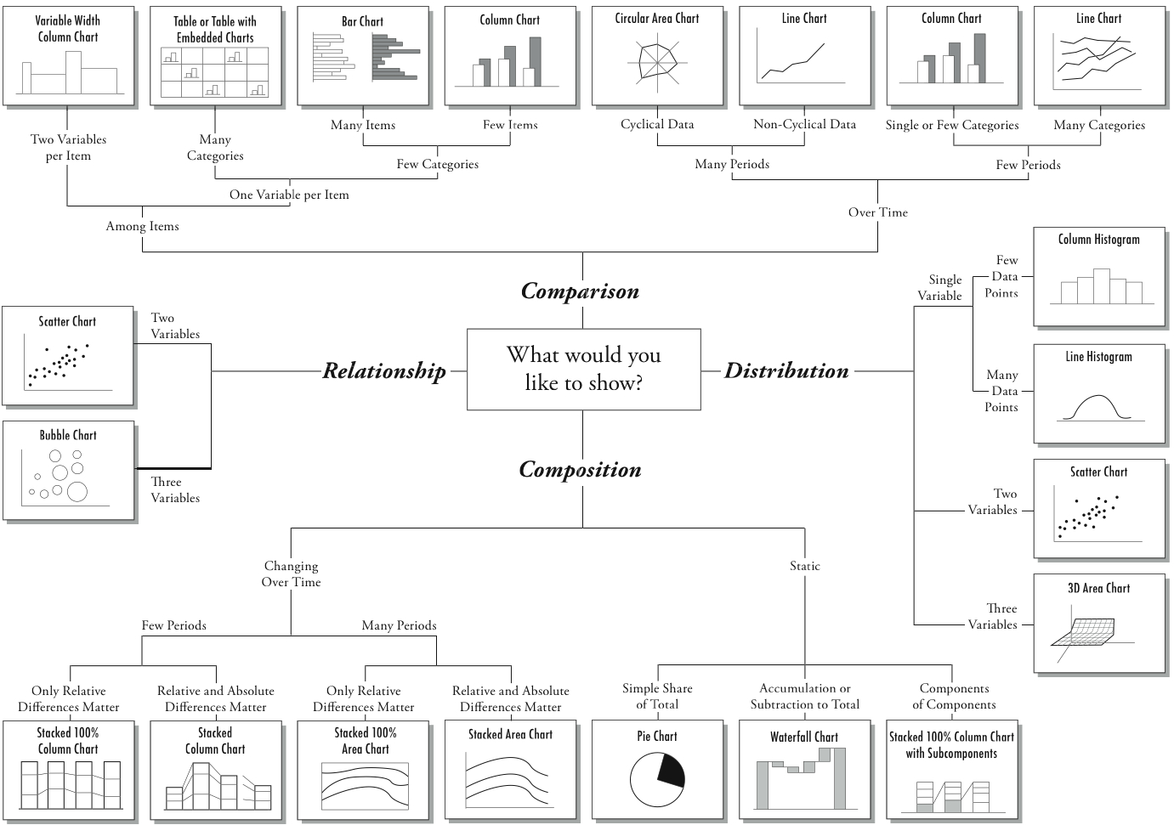
Theory of Data Graphics
Building a Great Visual

Slide 37
Theory of Data Graphics
Building a Great Visual
Summary
Visuals help tell the story better than words or tables
Be wary of putting too much information into a graph. Simple is best!
The four Os can help guide you to design a good graph: Objective, Observable, Original and Open.
The four Cs (sort of) make your graph complete and help it stand-alone: Title, Caption, Citation, Color.

Slide 38
ggplot() Basics

Slide 39
Theory of Data Graphics
ggplot() basics
ggplot() is the go-to R package for graphics.
It operates on the concept of the Grammar of Graphics
The Grammar of Graphics follows the following format
Data
Aesthetics
Geom
Statistics / Transformations

Slide 40
Theory of Data Graphics
ggplot() basics
ggplot() is the go-to R package for graphics.
data – Your dataset, in this case “dta”
ggplot(dta, ...
aesthetics – Your variables, in this case “var1” and “var2”
ggplot(dta, aes(x=var1, y=var2))…
geoms – The shape of your graph (there are MANY!)
ggplot(dta, aes(x=var1, y=var2))+geom_line()
statistics / transformations – Transformations to the data
(Not Recommended, because you should transform your data before plotting)

Slide 41
Theory of Data Graphics
ggplot() basics
#I. Setup ----------------------------------------------------------------------------
# A. Clear environment
rm(list = ls())
# B. Set working directory
setwd("C:/users/jguinta/desktop/")
# C. Import custom functions
# D. Import packages
require(tidyverse)
require(data.table)
require(dtplyr)
require(stringr)
#II. Data Loading -------------------------------------------------------------------
covid_st_d<-fread("./002_covid_daily_us_cln.csv") #You can get this data on my github at github.com/jjghockey
#III. Data Processing ---------------------------------------------------------------
#A. Variable transformations for plotting
covid_st_d[, region:=as.factor(region)]
covid_st_d[, src:=as.Date(src)]
#B. Filtering to Contiental/Contiguous 48
covid_st_d<-covid_st_d[state_cln!="unk" & state_cln!="ter" & state_cln!="pr" & state_cln!="dc" & state_cln!="hi" & state_cln!="ak", ]
#C. Filtering to March 2020 forward
covid_st_d<-covid_st_d[src>=as.Date("2020-03-01"), ]

Slide 42
Theory of Data Graphics
ggplot() basics
#IV. Data Analysis ------------------------------------------------------------------
#A. Graphs
#Infection Rate – Ordered by Rate of Infection by State
dta<-covid_st_d[src==max(covid_st_d$src),.(state_cln, infections_pp100)]
ord<-dta[, .(state_cln, infections_pp100)][order(-infections_pp100)][, .(state_cln)] %>% pull()
dta[, state_cln:=as.character(state_cln)]
dta[, state_cln:=factor(state_cln, levels=c(ord))]
head(dta)

Slide 43
Theory of Data Graphics
ggplot() basics
p<-ggplot(dta, aes(x=state_cln, y=infections_pp100)) + geom_bar(stat="identity")
p<-p+theme_classic()
p<-p+labs(title="Infection Rate per 100,000", subtitle="United States by State Code", x="State", y=paste("Infection Rate as of", max(covid_st_d$src), sep=" " ))
p1<-p+coord_flip()
p1
Data – Object identified as “dta”
Aesthetic – X axis – identified as “state_cln” and Y axis – identified as “infections_pp100”
Geom – geom_bar()
Creates a bar chart
Stat=“identity” is a statistical transformation. You MUST use it in a bar chart if you pre-aggregate your data and set both x and y aesthethics.
Format – theme_classic() Preset theme for the graph
Titles and Labels – labs(title="Infection Rate per 100,000", subtitle="United States by State Code", x="State", y=paste("Infection Rate as of", max(covid_st_d$src), sep=" " ))
coord_flip() – Flips the x and y axes

Slide 44
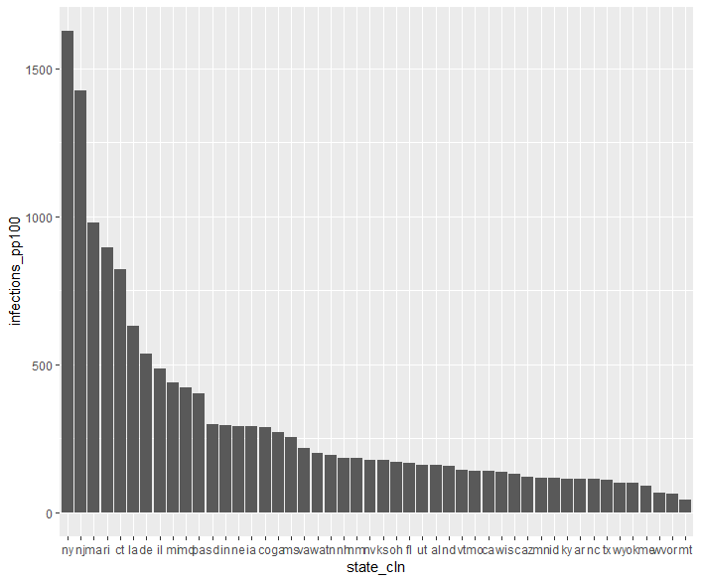
Theory of Data Graphics
ggplot() basics
p<-ggplot(dta, aes(x=state_cln, y=infections_pp100)) + geom_bar(stat="identity")
p

Slide 45
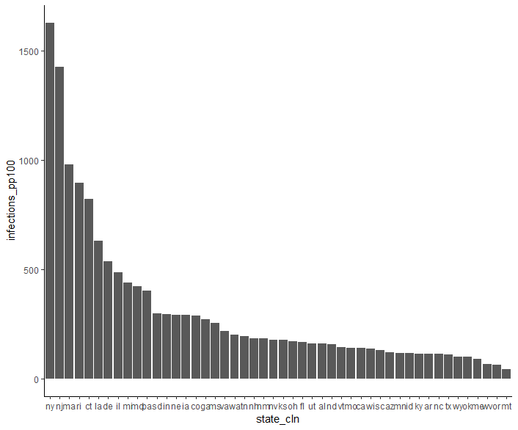
Theory of Data Graphics
ggplot() basics
p<-ggplot(dta, aes(x=state_cln, y=infections_pp100)) + geom_bar(stat="identity")
p<-p+p<-p+theme_classic()
p

Slide 46
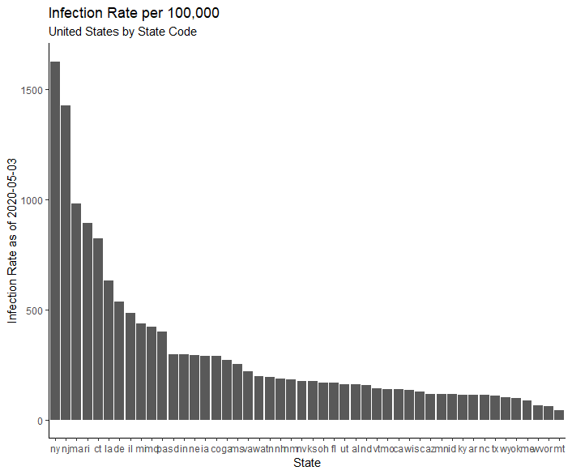
Theory of Data Graphics
ggplot() basics
p<-ggplot(dta, aes(x=state_cln, y=infections_pp100)) + geom_bar(stat="identity")
p<-p+theme_classic()
p<-p+labs(title="Infection Rate per 100,000", subtitle="United States by State Code", x="State", y=paste("Infection Rate as of", max(covid_st_d$src), sep=" " ))
p

Slide 47
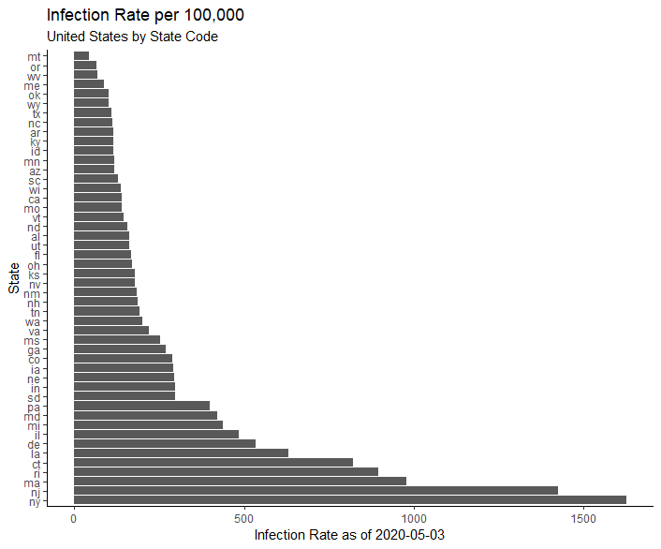
Theory of Data Graphics
ggplot() basics
p<-ggplot(dta, aes(x=state_cln, y=infections_pp100)) + geom_bar(stat="identity")
p<-p+theme_classic()
p<-p+labs(title="Infection Rate per 100,000", subtitle="United States by State Code", x="State", y=paste("Infection Rate as of", max(covid_st_d$src), sep=" " ))
p+coord_flip()

Slide 48
Theory of Data Graphics
ggplot() basics
p<-ggplot(covid_st_d[state_cln %in% c("ca", "ny", "il", "az", "fl", "tx")], aes(x=src, y=infections_pp100, color=state_cln)) + geom_line()
p<-p+facet_wrap(~state_cln, ncol=3, nrow=3, scales="free")
p<-p+theme_classic()+theme(legend.position = "none")
p<-p+scale_color_manual(values=c("red", "dark red", "grey", "blue", "black", "light blue", "black"))
p2<-p+labs(title="Infection Rate per 100,000", subtitle="United States by State Code", x="Date", y="Infections Per 100,000")
#p2+ scale_y_continuous(trans=‘log’) #Optional, but change your labels and titles.
Data – Object identified as “covid_st_d”
Aesthetic – X axis – identified as “src” and Y axis – identified as “infections_pp100”, color – Coloring of the values based on the “state_cln variable”
Geom – geom_line()
Facet_wrap() – Groups the data into specific categories
Format – theme_classic() Preset theme for the graph
Scale Color Manual – Manually set the colors
Titles and Labels – labs(title="Infection Rate per 100,000", subtitle="United States by State Code", x=“Date", y=“Infections per 100,000”)
scale_y_continuous(trans=‘log’) – Transform the Y axis to a natural log. OPTIONAL. Changes the entire meaning of your output.

Slide 49
Theory of Data Graphics
ggplot() basics
head(covid_st_d[, .(src, state_cln, infections_pp100)])

Slide 50
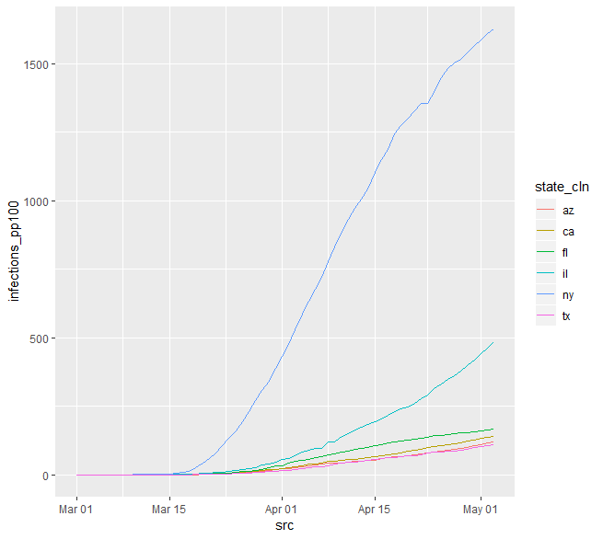
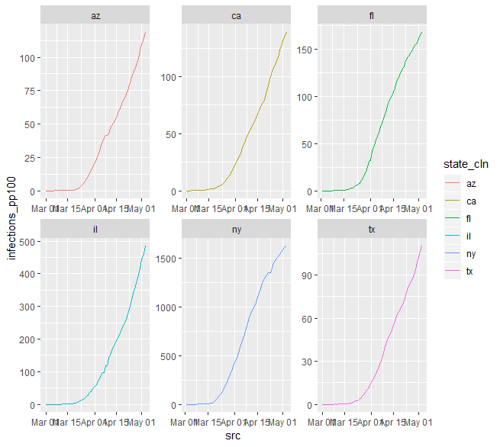
Theory of Data Graphics
ggplot() basics
p<-ggplot(covid_st_d[state_cln %in% c("ca", "ny", "il", "az", "fl", "tx")], aes(x=src, y=infections_pp100, color=state_cln)) + geom_line()
p
p<-p+facet_wrap(~state_cln, ncol=3, nrow=3, scales="free")
p
Without facet_wrap()
With facet_wrap()

Slide 51
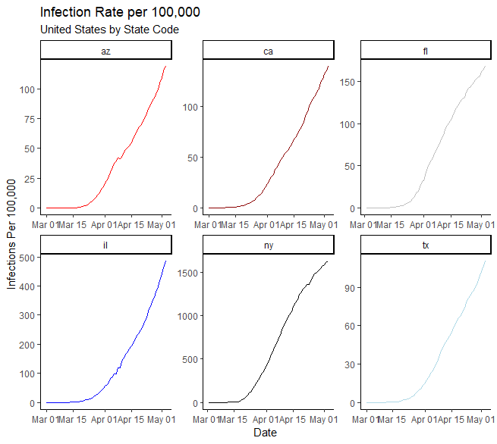
Theory of Data Graphics
ggplot() basics
p<-p+theme_classic()+theme(legend.position = "none")
p<-p+scale_color_manual(values=c("red", "dark red", "grey", "blue", "black", "light blue", "black"))
p2<-p+labs(title="Infection Rate per 100,000", subtitle="United States by State Code", x="Date", y="Infections Per 100,000")
p2

Slide 52
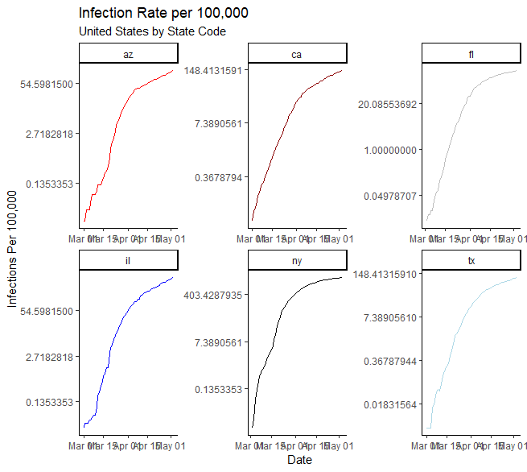
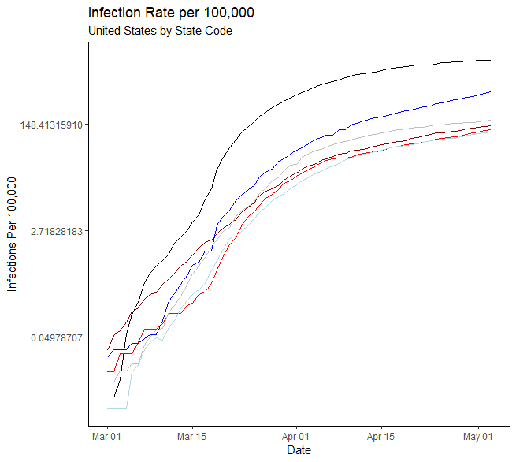
Theory of Data Graphics
ggplot() basics
p2 + scale_y_continuous(trans=‘log’)
p2 + scale_y_continuous(trans=‘log’)
With facet_wrap()
WithOUT facet_wrap()
NOTE: If you perform transformation like this, you should do them BEFORE you label and title the graphs. Since I did afterward, the original labels and titles are not accurate to the transformation, so they need to be adjusted.

Slide 53

Questions?
Jeremy Guinta
jeremy.guinta@ankura.com

